Slide 1
Civil society

Slide 2
What is civil society?

Slide 3
United Nations Development Program
‘Civil society is an arena of voluntary collective actions around shared interests, purposes and values distinct from families, state and profit seeking institutions. The term civil society includes the full range of formal and informal organizations that are outside the state and the market – including social movements, volunteer involving organizations, mass-based membership organizations, faith-based groups, NGOs, and community-based organizations, as well as communities and citizens acting individually and collectively.

Slide 4
‘What Is Civil Society?’, London School of Economics
Civil society is the arena of uncoerced collective action around shared interests, purposes and values. In theory, its institutional forms are distinct from those of the state, family and market, though in practice, the boundaries between state, civil society, family and market are often complex, blurred and negotiated. Civil society commonly embraces a diversity of spaces, actors and institutional forms, varying in their degree of formality, autonomy and power.

Slide 5
Civil Society: Definitions and Approaches’, John Keane
‘Civil society is a realm of social life – market exchanges, charitable groups, clubs and voluntary associations, independent churches and publishing houses – institutionally separated from territorial state institutions.

Slide 6
‘Assessing the State of Civil Society: A Toolkit for the CIVICUS Civil Society Index (CSI)’
CIVICUS Civil society is the arena – outside of the family, the state, and the market – which is created by individual and collective actions, organizations and institutions to advance shared interests.

Slide 7
Johns Hopkins University Center for Civil Society Studies
A civil society organization is an entity that is:
Organized, i.e., institutionalized to some extent.
Private, i.e., institutionally separate from government.
Non-profit-distributing, i.e., not returning profits generated to their owners or directors.
Self-governing, i.e., equipped to control their own activities.
Voluntary, i.e., involving some meaningful degree of voluntary participation.

Slide 8
‘The Kenyan CSO Standards’
Civil society organizations:
Are driven by values that reflect a desire to improve lives;
Contain elements of voluntarism (i.e. free choice of association, voluntary contributions of time and money);
Have private and independent governance;
Are not for profit (i.e. do not distribute profit to staff and/or shareholders);
Have clearly stated and defined public purposes for which they are accountable;
Are formally constituted under the law and have an accepted identity in line with the culture and traditions prevailing in the country.

Slide 9
What conditions are necessary for a healthy civil society?

Slide 10
How does civil society impact democracy?

Slide 11
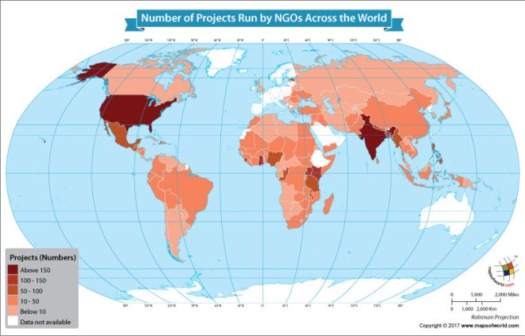

Slide 12
Types of civil society

Slide 13
Pluralism
Many organizations
Freedom to join and lobby
Compete to win influence or access to government
Represent wide range of population

Slide 14
Patron-clientism
Focus on leader-follower in favor exchange system
Indicative of corrupt regimes (bribes)
Rarely insist on legal separation laws
  Conflict of interest rules
  Open, competitive contracts
  Anti-nepotism laws
Usually imbedded in culture

Slide 15
corporatism
State supports movements (directly or indirectly)
Businesses support movements (directly or indirectly)
State involved in governance/approval of actions

Slide 16
China corporatism & Patron-clientism
China used to be way more pluralist than it is now.
2012 over a million NGOs (many not registered)—since then there has been a rapid decrease in NGOs and the freedom they have from the government
Government consolidating power in the name of “streamlining for efficiency”
Severe crack down on NGOs especially related to human rights
Citizenship score is incorporating civil society participation (right v wrong NGOs)
Foreign NGOs are under public safety—lots of laws to make NGOs in China difficult
Rule by law—They follow the law so word by word—they passed the charity law that look like more transparency, but really more government control
Chinese government tells NGOs what to do—they are Gos
Bottom-up civil society doesn’t exist—top down machinations stunted growth of civil society
Lots of focus on CCP approval and leader

Slide 17
Great Britain pluralism
There are a lot of charities, unions, trusts, etc. (millions of members)
Known for human rights and discourse on rights
Lots of charities and rights-autism etc.
Free to join
Many unique perspectives represented (youth, educators, women’s groups)
Passed lobbying act—charities have to register if they spend certain amount influencing voters before elections
Pretty clear pluralism….

Slide 18
Nigeria pluralism with some corporatism-ish movement
Current bill to restrict NGO freedom (being protested etc)
  Would require registration with government
  Would allow government to deny registration (ie. No anti-corruption NGOs)
  Would require government approval of certain activities
  Would have to report all finances to government
Biggest organization of NGOs—network of Nigerian NGOs (2400) to promote cooperation and government recognition
NGOs protected and listed in 1999 constitution
Nigerian Labor Congress protects worker and citizens rights (another big org)
Network of NGOs does a lot to help with poverty relief in Nigeria (take up slack from government)
A lot of the CSOs are being used as bridge between government and people (linkage institutions)

Slide 19
Iran corporatism/pluralism/non-existent at all
Some approved NGOs allowed, ie. Islamic charities
About 5-8000 NGOs total, mostly non-approved
Only approved NGOs (of government aligned NGOs) can do anything (non-approved hope for online presence and awareness and hope not to get caught)
No workers unions allowed
Freedom of assembly allowed but impeded by state-sponsored terrorist group (Basij, Ansar-i-Hezbollah)
No foreign NGOs
Not much hope for any change at all….☹

Slide 20
Russia
Patron-clientism/corporatism*
Putin shifting toward corporatism
No foreign NGOs (all spies?)
Government directly funds all largest NGOs
  450,000 approved NGOs
  Some unapproved
  Approval based on willingness to cooperate with government (support government agenda)
  People’s donations to NGOs go through government (give government control of money and ability to cut off funding)
Russian political culture does not support NGO/civil society participation
Civil society almost another branch of government

Slide 21
Mexico
Pluralism
Reg underpromoted
Authorized donees
Tax exemption and deductions as an incentive
Requirements—assets used for public benefit, and other regs of income tax act
Obrador looking to cut government funding for NGOs
Law for the identification of operating with resources?
  40,000 (50s 9,000) authorized NGOs—growing
  Over 6,155 $ must identify funds
  Over 12,310 $ must report to financing intelligence unit
Change from 1990s….
  Many, many more NGOs (quadrupled since mid-nineties)
  Change from patron-client

